Slide 1
Responding to Emerging Threats Amidst the Shitpile of Vulnerability Debt
Patrick Garrity
(Security Researcher @ VulnCheck)

Slide 2
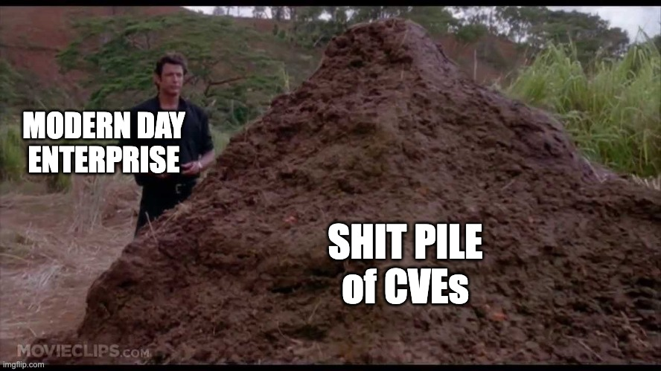

Slide 3
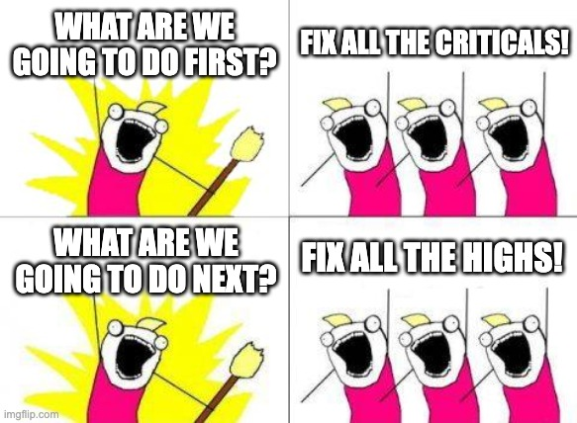

Slide 4


Slide 5
Is CVE Growth Really The Problem Causing Your Backlog?

Slide 6


Slide 7

CVE Growth 2020-2024
# of CVEs Published
CVE Publish Year

Slide 8
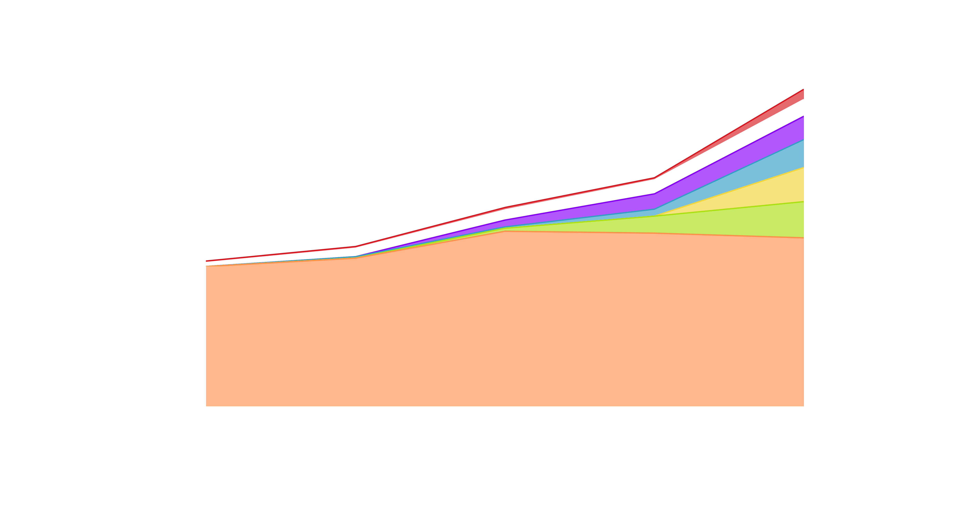
What is Behind the Exponential Growth of CVEs?
(Wordpress)
(Linux)
(Wordpress)
(Misc)
(Open Source)
(Bug Bounty)
# of CVEs Published
CVE Publish Year

Slide 9
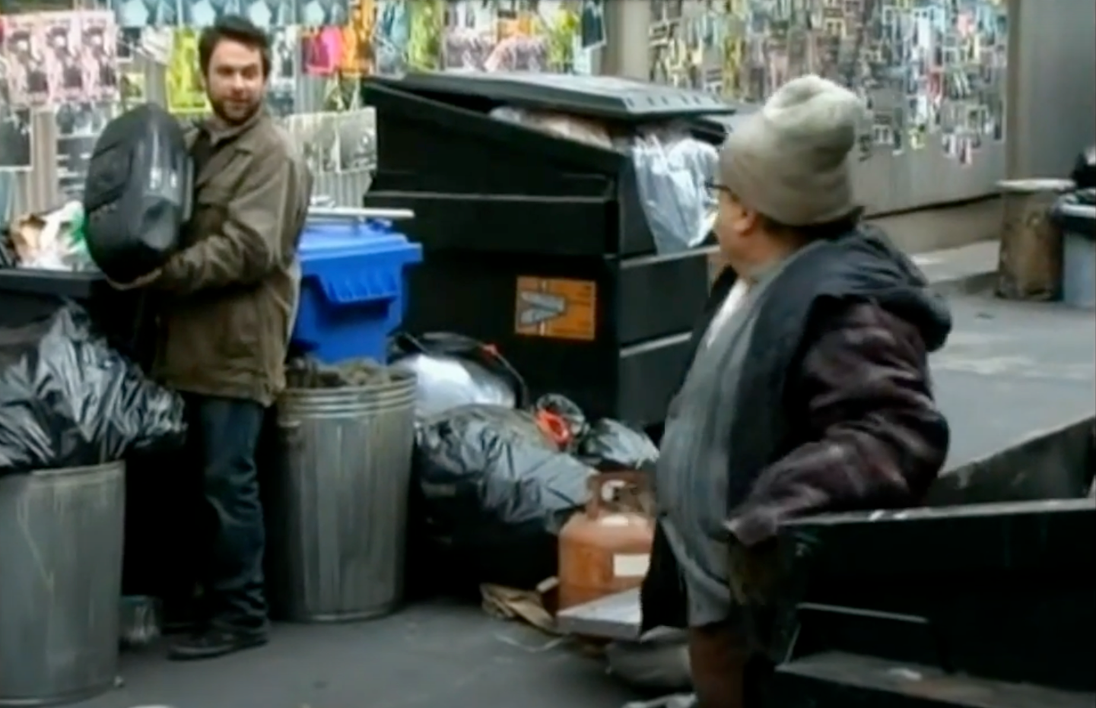
The Glamorous Life of
Emerging Threats

Slide 10


Vulnerability Threat Matrix
Ransomware
Botnet
Known Exploited
Threat Actor (APT)
Unattributed KEV
Weaponized
Exploit Availability
Proof-of-Concept
All Other CVEs
Notes:
Exploited by Threat Actors who previously targeted my Organization
Exploited by Threat Actors who previously targeted similar Organizations
Exploited by Threat Actors (APT, Ransomware, Botnets)
Known Exploited In-the-Wild (ITW) [i.e., exploited by unknown parties]
Exploit Weaponization (i.e., in MetaSploit, in commercial or public/private Exploit Kits)
Exploit Proof of Concept Code available (RCE, LPE)
Code available that crashes the service
Very recent CVE (past week) which is very similar to past CVEs that are above (i.e., QNAP Command Injection released)
All CVEs

Slide 11
Known Exploited Vulnerabilities
Not Just CISA KEV

Slide 12





How are we defining KEV?
Any vulnerability publicly-reported
as exploited in the wild.
Automated collection & Third Party Reporting that is Curated by my security research team.
Trusted Sources
Automated KEV

Slide 13
Important Details about KEVs
Emerging Threat (Fix Fast)
Evidence is all Public Record
If there is no CVE > Coordinate to get a CVE issued timely
Work Closely with other Intel firms on vulnerability / exploitation disclosure
There are many ways people define exploitation differently

Slide 14
What Does This Research Include?
Exploitation that was disclosed for the first time in 2025-1H.
432+ Known Exploited Vulnerabilities
914+ KEV Reference Citations*
30 Known Ransomware

Slide 15
How the Year Started

Slide 16








CONFIRMED EXPLOITATION
2025 YEAR-TO-DATE (01/01-01/15/2025)
01/02
01/07
01/07
01/08
01/08
Xiaomi Mi
WiFi R3G
Aviatri
Controller
Mitel
MiCollab
Ivanti
Connect Secure
Ivanti
Connect Secure
1/13
CVE-2019-18371
Source: Shadow Server
CVSS-BT: 7.5
EPSS: 3.37%
CVE-2024-50603
Source: Aviatrix / Wiz
CVSS-BT: 10
EPSS: 0.96%
CVE-2024-55550
Source: CISA
CVSS-BT: 4.4
EPSS: 42.71%
CVE-2025-0282
Source: Ivanti
CVSS-BT: 9
EPSS: 15.33%
CVE-2025-0283
Source: NCSC
CVSS-BT: 7
EPSS: 0.04%
Repetier
Server
CVE-2023-31059
Source: Shadow Server
CVSS-BT: 7.5
EPSS: 1.89%
1/14
1/14
1/14
1/14
?
Microsoft
Windows Hyper-V
Microsoft
Windows Hyper-V
Microsoft
Windows Hyper-V
Fortinet
FortiOS
?
CVE-2025-21335
Source: Microsoft
CVSS-BT: 7.8
EPSS: 0.14%
CVE-2025-21334
Source: Microsoft
CVSS-BT: 7.8
EPSS: 0.14%
CVE-2025-21333
Source: Microsoft
CVSS-BT: 7.8
EPSS: 0.14%
CVE-2024-55591
Source: Fortinet
CVSS-BT: 9.8
EPSS: 1.18%
?

Slide 17
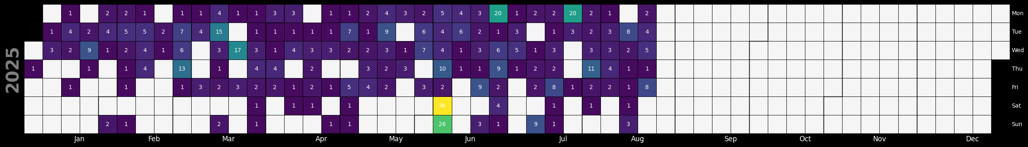

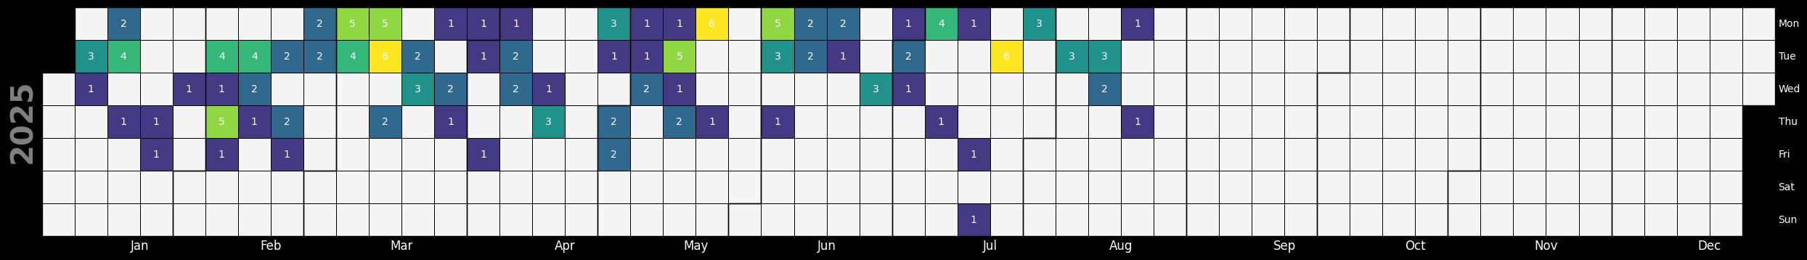
KEVs
CISA KEV

Slide 18
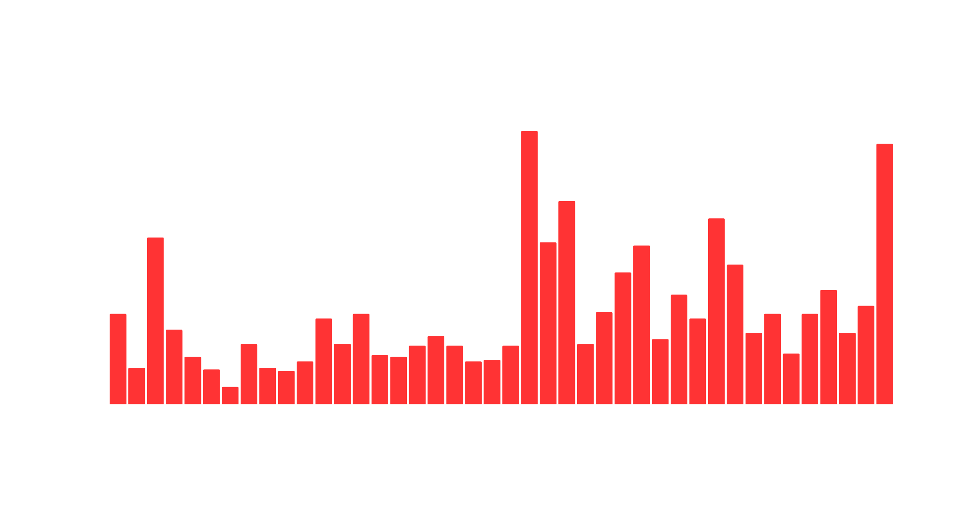

Known Exploited Vulnerabilities
# of New KEVs
Month

Slide 19





































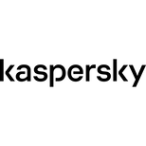





Earliest Reporters of
Exploitation in the Wild
Fearsoff
Sekoia
Cofense
Reliaquest
NCSC
Forescout
Qianxin
rt-security
Aviatrix
Gladinet
Security
Week
The
Hacker
News
Olegzay
KB CERT
Kevintel
Japan
Vulnerability
Notes
Onapsis
Chocapikk
NCC
Group
Hunter
Strategy
WPscan
Falcon
Feeds
Sensepost
Step
Security
CERT
PL
Horde
Cyberreason

Slide 20

CVE Assignment for Exploited Vulns
57 detections w/o CVEs analyzed
3 detections deemed non-CVEable (well-documented, non-default configs/features)
35 CVEs assigned
28 CVEs correlated

Slide 21
Let’s Look at a few KEVs

Slide 22







LANGFLOW AI COORDINATED DISCLOSURE
DISCOVERED BY HORIZON3.AI | CVE-2025-3248 | LANGFLOW AI
02/22
02/24
02/25
2/26
3/5
Vulnerability Reported to Langflow
Escalated Through Github Issue
Escalated Through HackerOne to DataStax
Escalated Through Email to Datastax (Acknowledged)
PR Fix Merged
Action: LangFlow AI
3/10
Action: Horizon3.ai
Action: Horizon3.ai
Action: Horizon3.ai
Action: Horizon3.ai
Request CVE
from Mitre
Action: Horizon3.ai
4/3
4/2
4/1
3/31
3/17
VulnCheck
Assigns CVE
Request CVE
from VulnCheck
Follow-up with Mitre for CVE
Fix Version Released
HackerOne
Responds
4/7
Action: VulnCheck
Action: Horizon3.ai
Action: Horizon3.ai
Action: LangFlow AI
(Already Fixed)
VulnCheck
Publishes CVE
4/7
4/9
4/12
5/5
Action: VulnCheck
Request to Cancel CVE Request
Exploit
Published
Exploitation Confirmed
Added to
CISA KEV
Action: Horizon3.ai

Slide 23
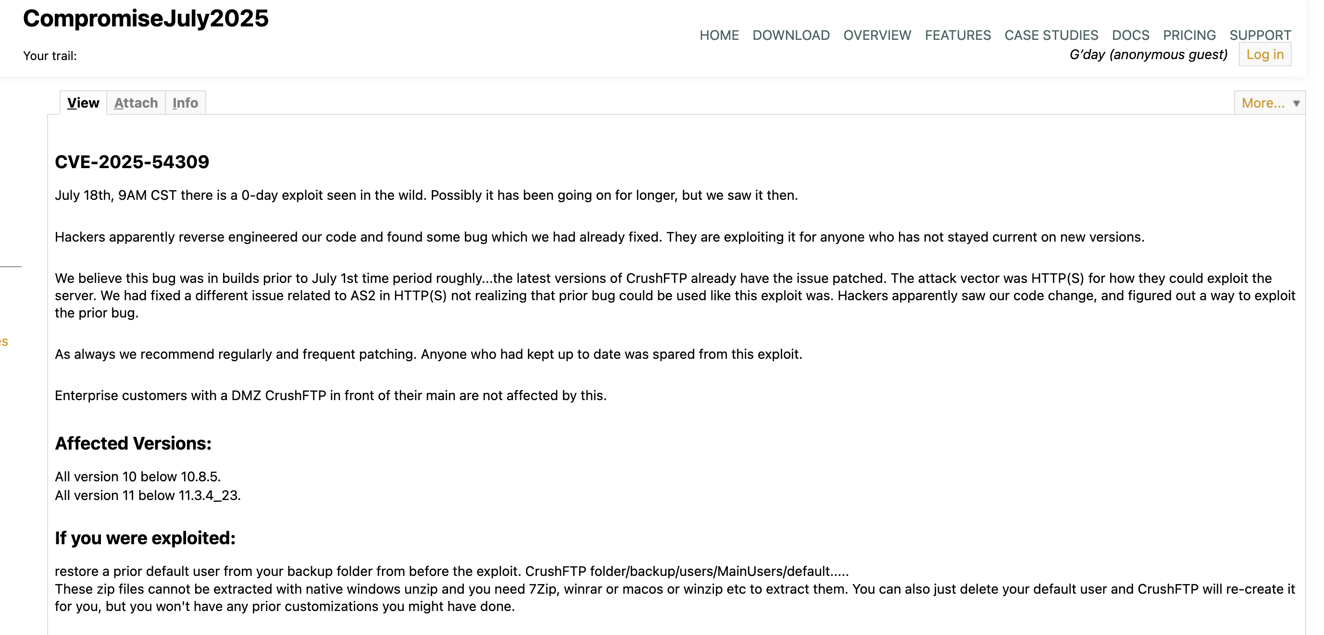
CrushFTP CVE-2025-54309

Slide 24
Just Use a Vulnerability
Scoring System for Prioritization

Slide 25
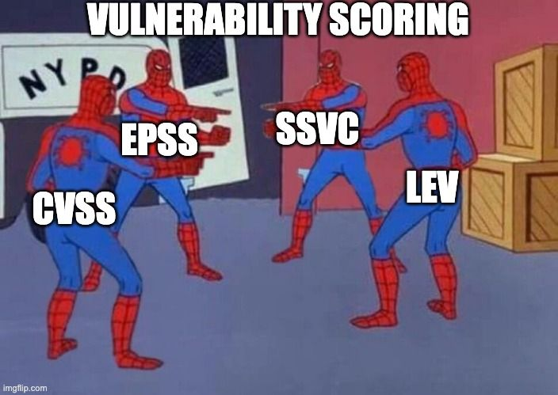

Slide 26
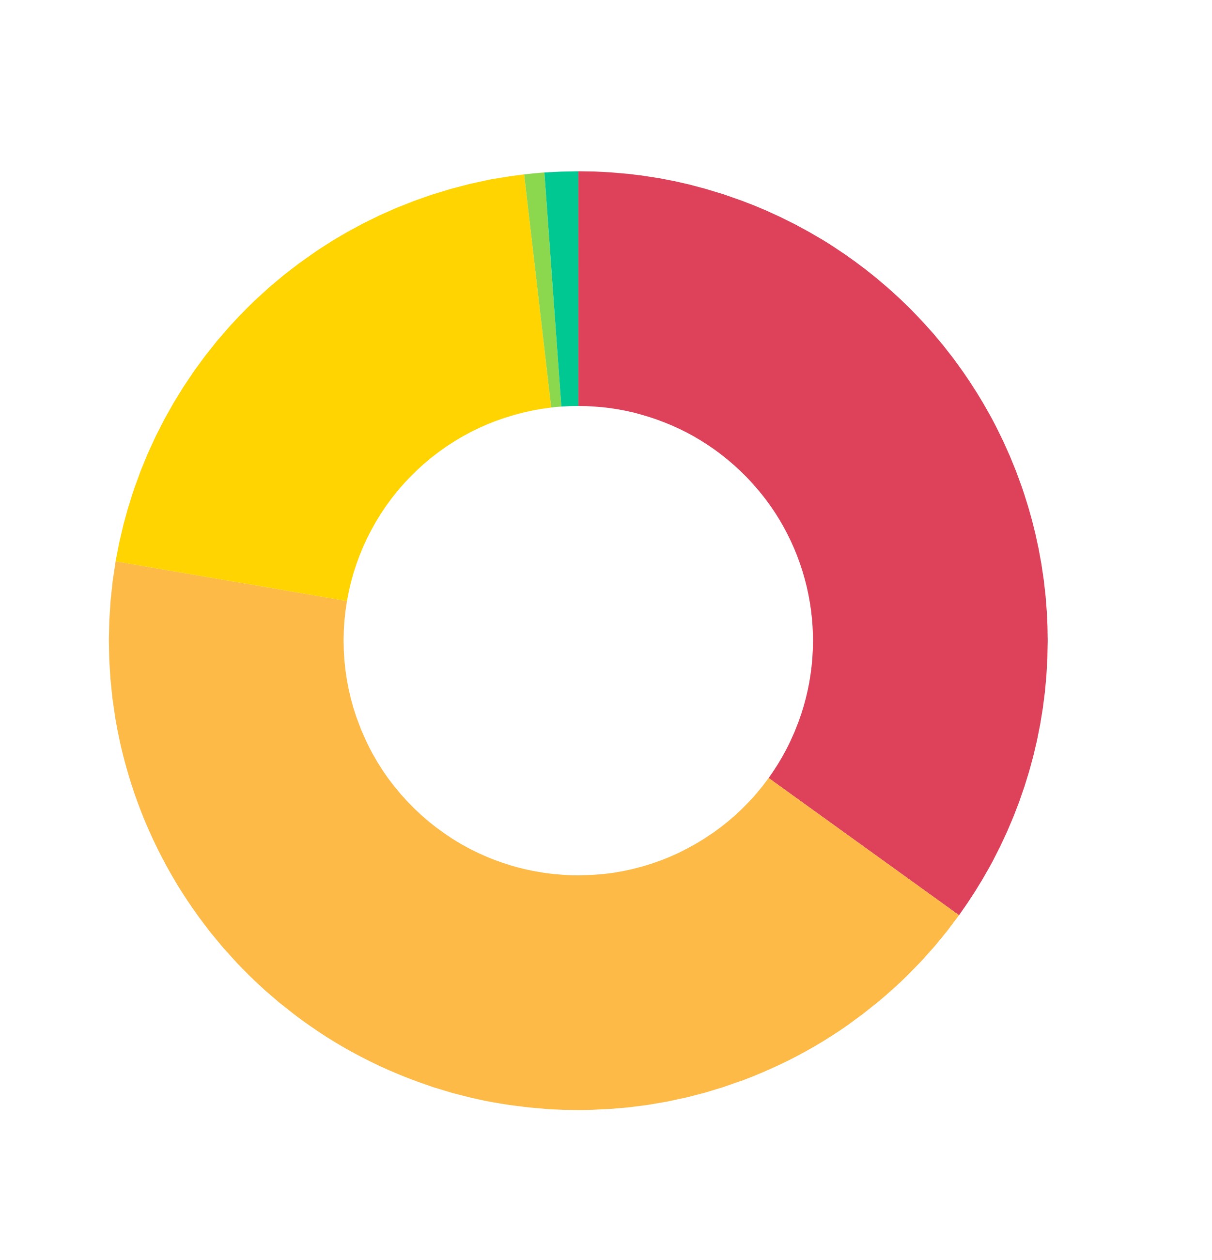
CVSS-B Severity

Slide 27
Just Use CVSS-BT

Slide 28
2025 Known Exploited Vulnerabilities
CVSS-B Severity
CVSS-BT Severity

Slide 29
EPSS Signal For Emerging Threats

Slide 30
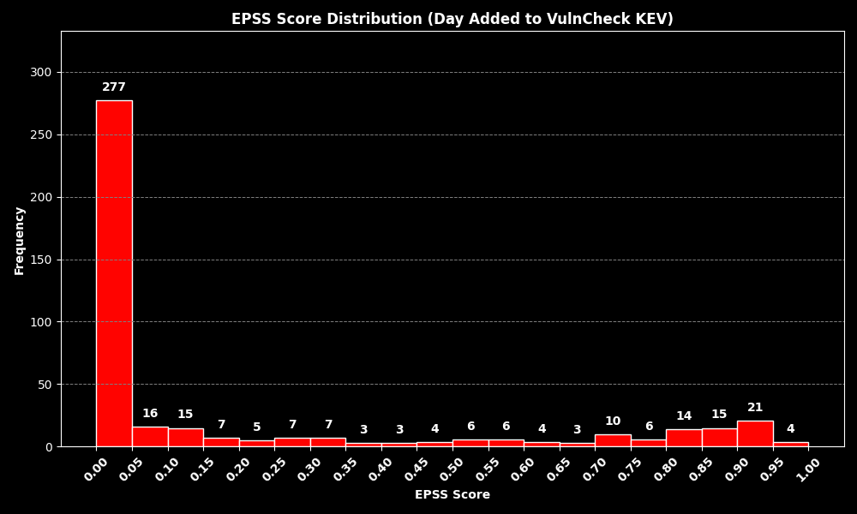
EPSS Score on Day Exploitation Evidence Reported

Slide 31
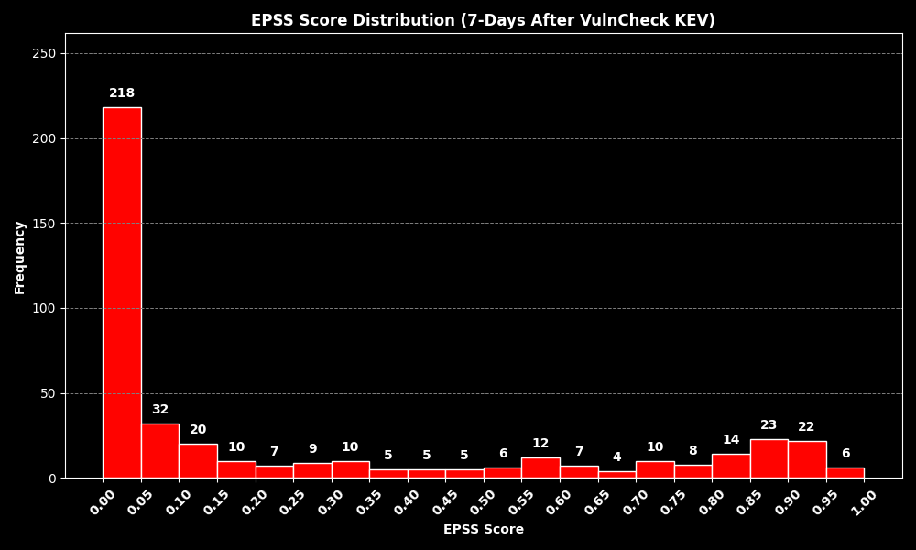
EPSS Score 7-Days After Exploitation Evidence Reported

Slide 32
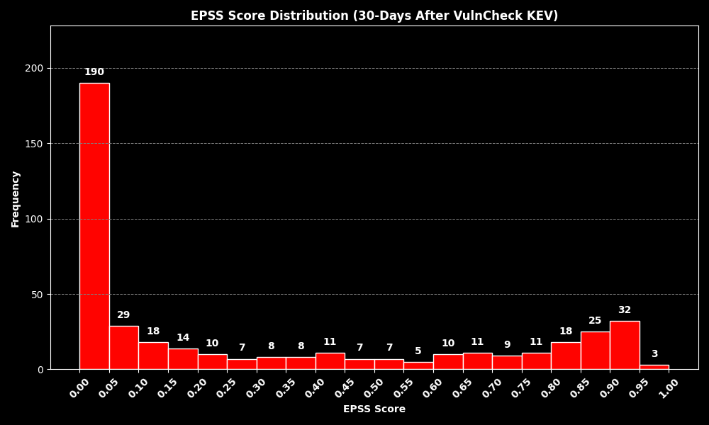
EPSS Score 30-Days After Exploitation Evidence Reported

Slide 33
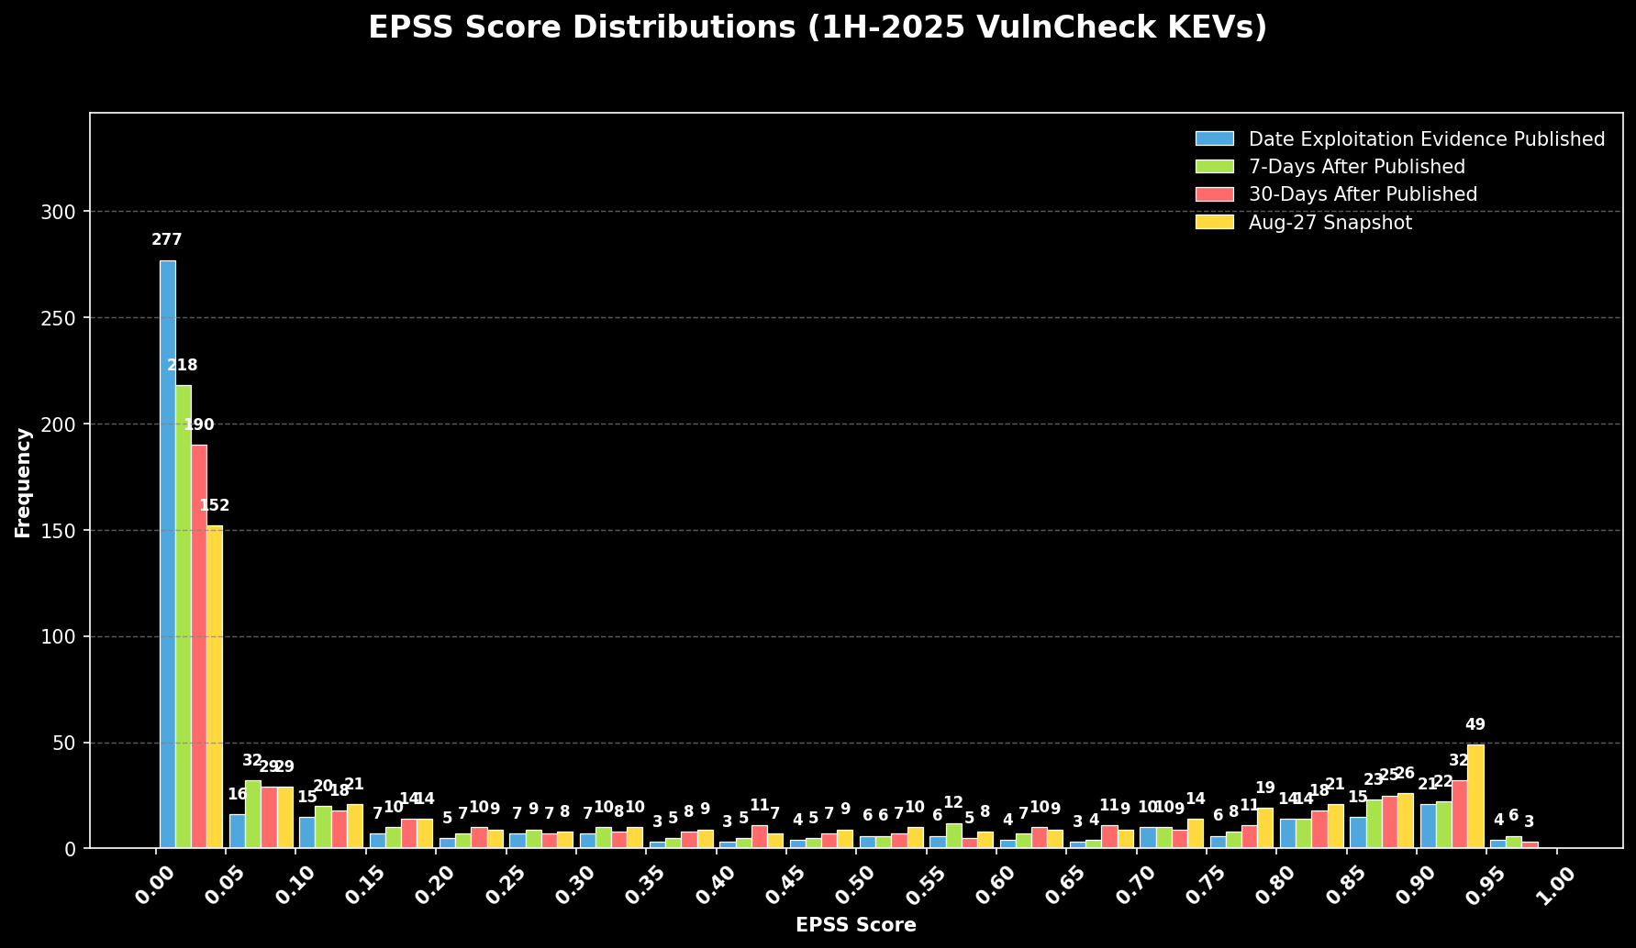
EPSS Score End of August

Slide 34
How Quickly are Vulnerabilities Being Exploited?

Slide 35
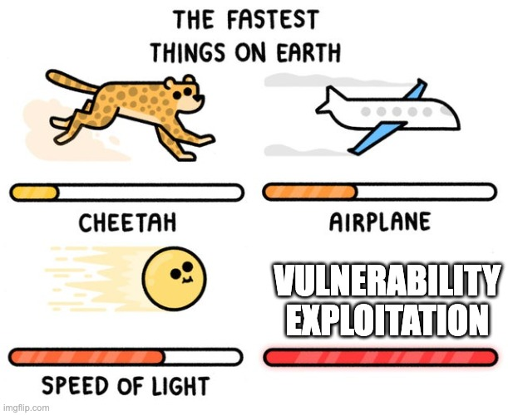

Slide 36

1H-2025 Known Exploited Vulnerabilities (432)
Time From CVE to Exploitation Evidence
Source: VulnCheck KEV
< 1 Day
139 (32.1%)
1 - 31 Days
38 (8.78%)
32 - 365 Days
95 (21.94%)
1-2 Year
44 (10.16%)
2-4 Years
55 (12.70%)
4+ Years
60 (13.86%)
Unpublished 1 (.23%)
Rejected 1 (.23%)

Slide 37
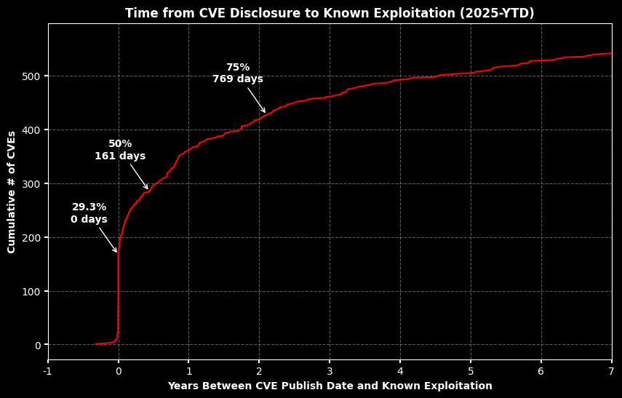

Slide 38
KEV Categorization

Slide 39
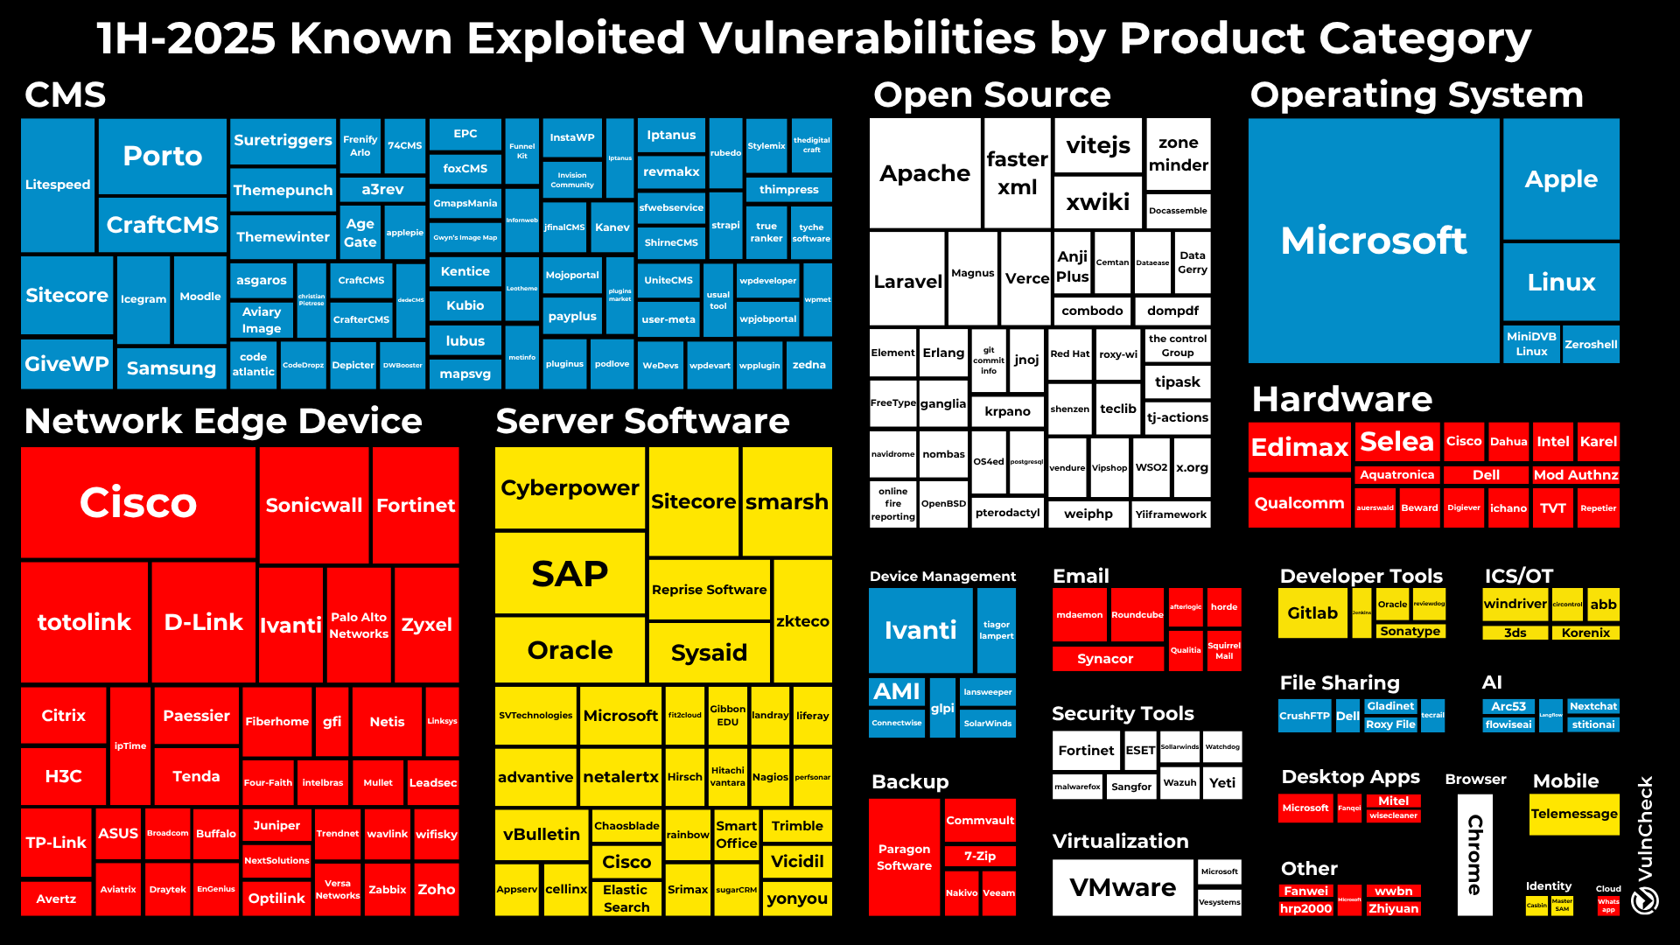

Slide 40
Ransomware

Slide 41
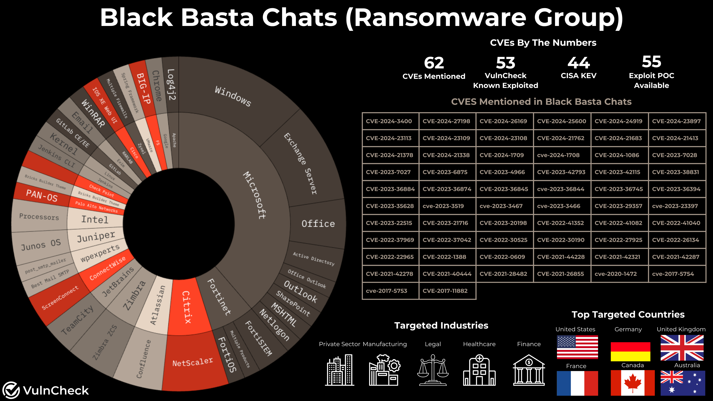

Slide 42
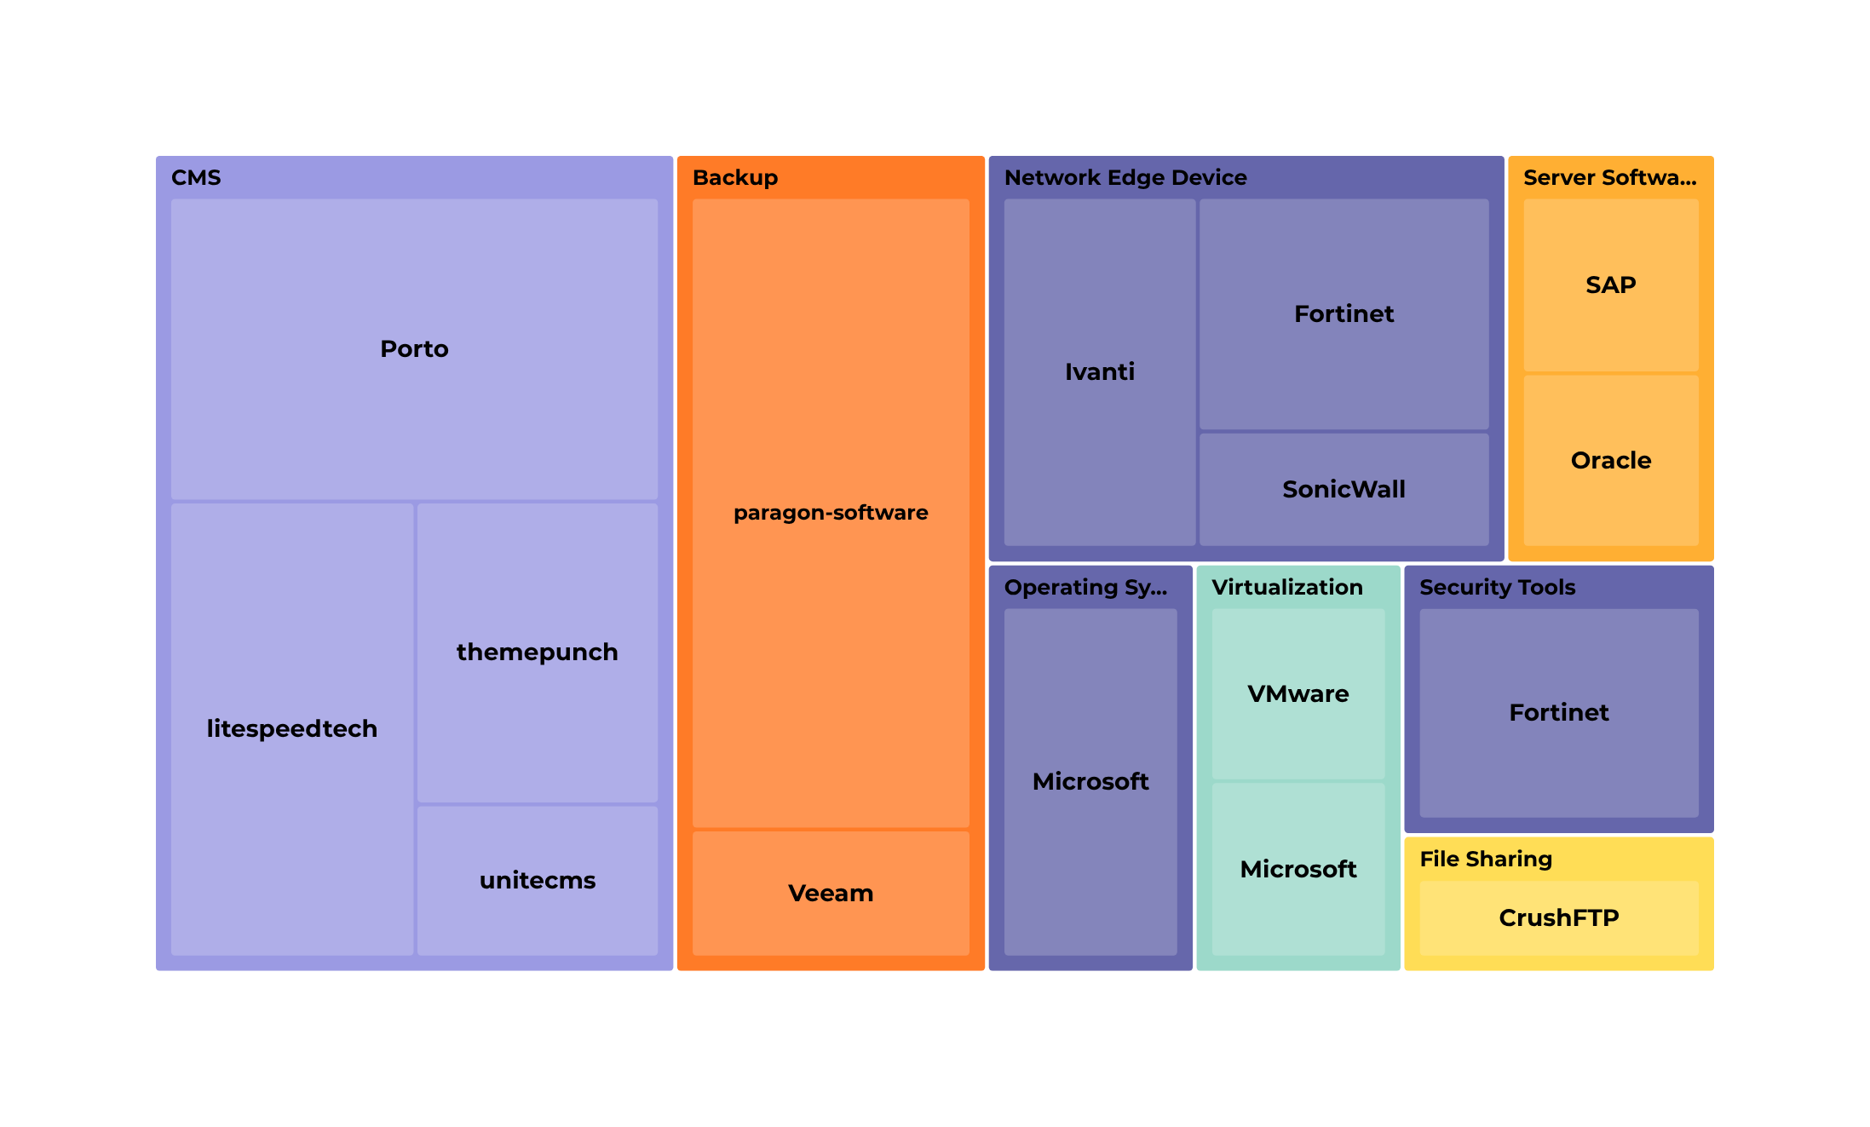
Ransomware Associated KEVs

Slide 43
Threat Actors

Slide 44











1H-2025 # of Unique Threat Actors Attributed by Country
North Korea
Iran
China
Russia
Turkey
Belarus
Palestine
India
Vietnam
Israel
UAE

Slide 45
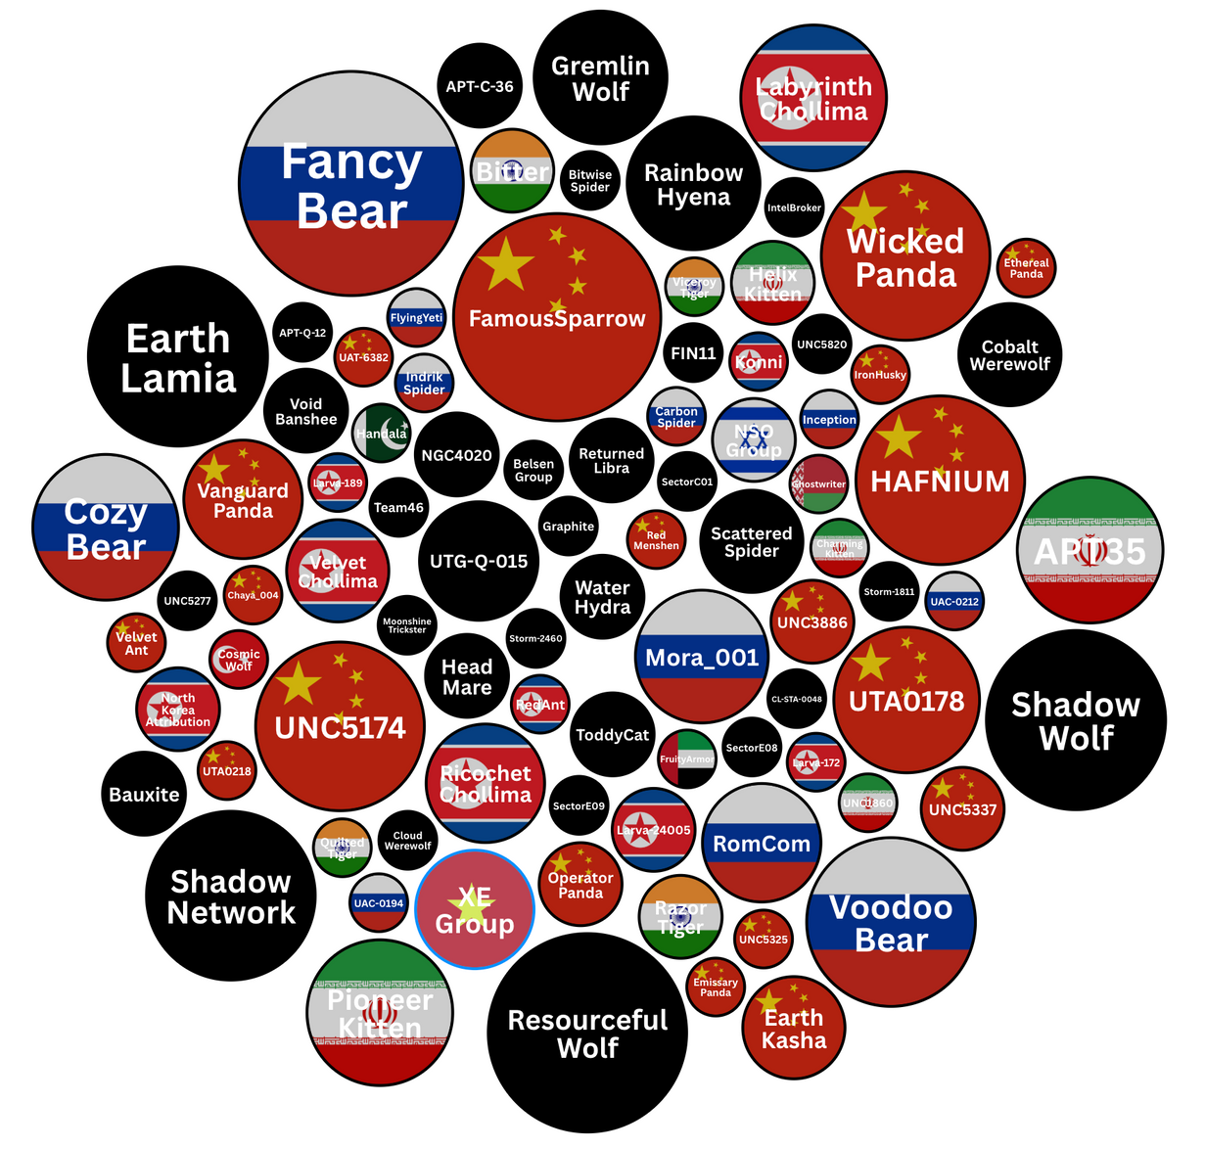
Threat Actor Attribution
# of Unique CVEs in 1H-2025
Source: VulnCheck Exploit Intelligence

Slide 46
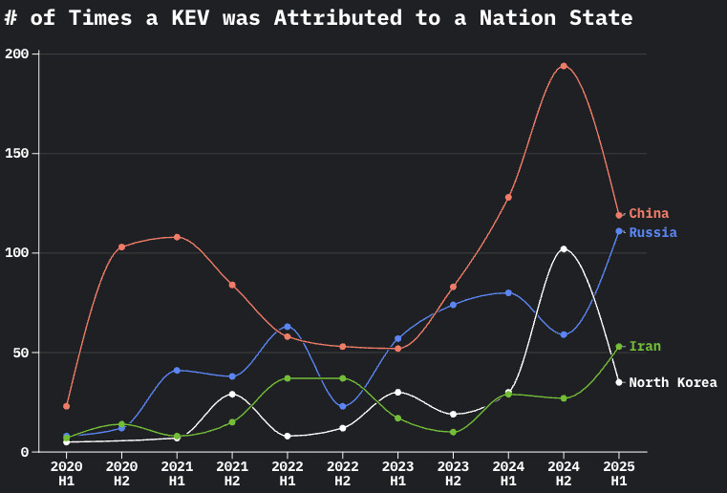

Slide 47
Emerging Threat & Vulnerability Debt

Slide 48
Emerging Threat
Vulnerability Debt
Vulnerability Debt
Rapid Response
Internet Facing
End User Interaction
Remotely Exploitable
Exploited or Soon to Be Exploited
Root Cause Analysis
Improve Patch Management
Automate Patching
Implement Best Practices
Prune Unused / EOL
Mitagating Controls

Slide 49
Vulnerability Threat Matrix
Ransomware
Botnet
Known Exploited
Threat Actor (APT)
Unattributed KEV
Weaponized
Exploit Availability
Proof-of-Concept
All Other CVEs
Notes:
Exploited by Threat Actors who previously targeted my Organization
Exploited by Threat Actors who previously targeted similar Organizations
Exploited by Threat Actors (APT, Ransomware, Botnets)
Known Exploited In-the-Wild (ITW) [i.e., exploited by unknown parties]
Exploit Weaponization (i.e., in MetaSploit, in commercial or public/private Exploit Kits)
Exploit Proof of Concept Code available (RCE, LPE)
Code available that crashes the service
Very recent CVE (past week) which is very similar to past CVEs that are above (i.e., QNAP Command Injection released)
All CVEs

Slide 50
Thank You!

Slide 51

